Slide 1
App Service Web App Architecture
Deployment
Server(s)
File Server
Publish Endpoint
Blob Storage
Application Database
Frontend (IIS ARR)
Microsoft Azure
Load Balancer
Metering
Runtime Database
API Endpoint

Slide 2
Debug Console (Kudu)
Environment
Debug Console
Diagnostics & Logs
Web Hooks
REST API
https://[website-name].scm.azurewebsites.net

Slide 3
App Service Web App
Web Site
Monaco
MSDeploy
Build/Upload Your Own
Kudu
Web Jobs
Gallery
Public Site Extensions
Private Site Extensions
Azure App Service Web App

Slide 4
Customizing the Deployment
>: azure site deploymentscript –h
help:
help: Generate custom deployment script
help: Usage: site deploymentscript [options]
help:
help: Options:
help: --aspWAP <projectFilePath>
help: --aspWebSite
help: --node
help: --php
help: --python
help: --basic
xplat-cli: Microsoft Azure Cross Platform Command-Line Tools

Slide 5
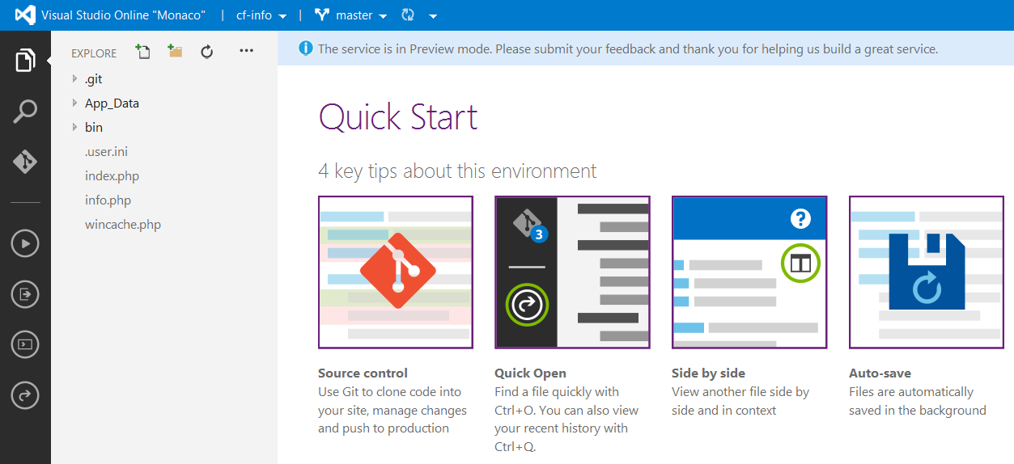
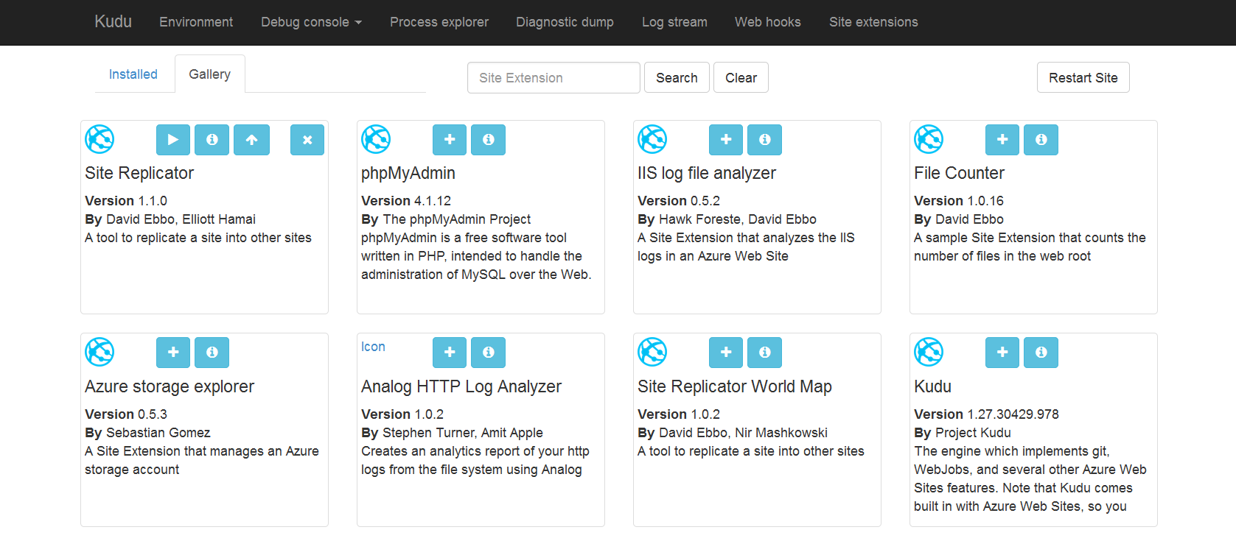
Site Extensions

Slide 6
WebSockets
Persistent Connection
Concurrent
Connections
5
35
350
Unlimited
Tier
Free
Shared
Basic / Standard
Premium

Slide 7


App Service Plan
$
+
+
Azure Subscription
Pricing Tier
Geographic Region
Notes:
App Service Plan is a scale unit for websites. It is comprised of a Geographic Region and a Pricing Tier within the same Azure Subscription. When you scale a site to either Basic or Standard all of the sites within the App Service Plan will be placed on the same Virtual Machine.

